Slide 1
Volcano & Lava
Created by Louis CHOULES

Slide 2
How to run the program
Open terminal and run the command below
> python3 viewer.py

Slide 3
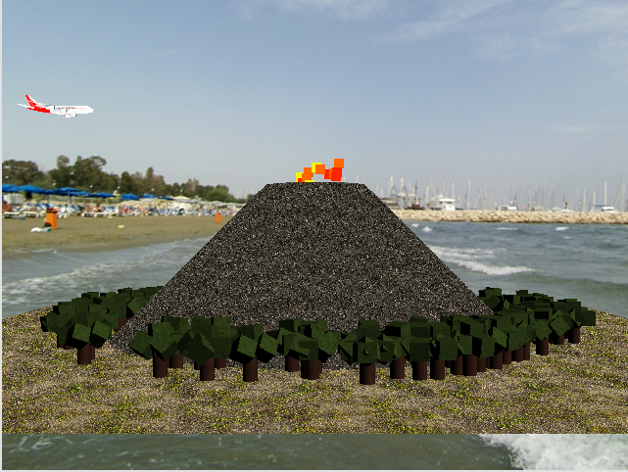
First Display
Objects:
Volcano
Lava & Particle
Tree
Terrain
Airplane
Skybox

Slide 4
Modeling
Objects:
Volcano
Lava & Particle
Terrain
Skybox

Slide 5
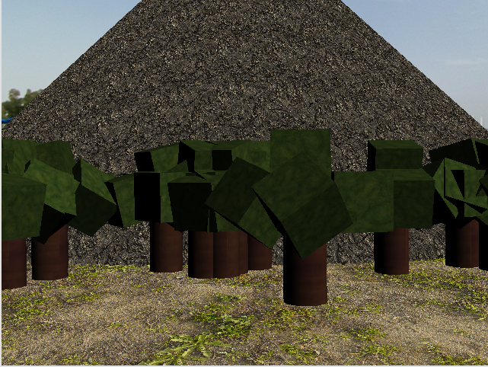
Hierarchical Object
Objects:
Tree

Slide 6
Lightning
Objects:
Tree (Lightning directly inside the shader [1,1,1])

Slide 7
Animation
Objects with animation:
Tree
Lava & Particle

Slide 8
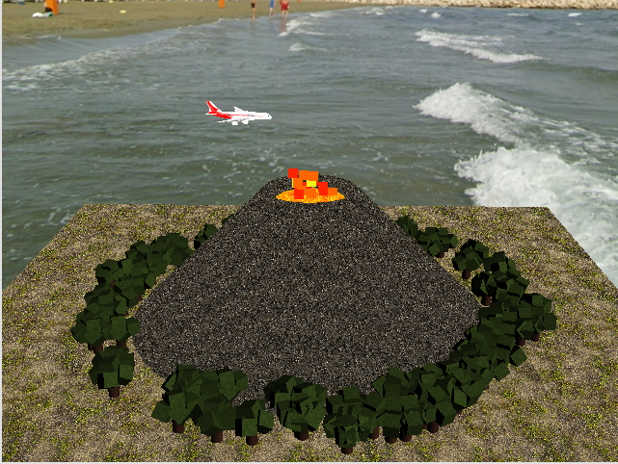
Controllable Object (Airplane)
- I: Move forward
- K: Move Backward
- J: Rotate Clockwise
- L: Rotate Anti-Clockwise

Slide 9
Credits
https://chamilo.grenoble-inp.fr/courses/ENSIMAG4MMG3D6/index.php
https://learnopengl.com/
https://www.youtube.com/@GetIntoGameDev
https://www.youtube.com/@CoderSpaceChannel

Slide 10
Thank You
Github
https://github.com/Louisc10/volcano_and_lava

